Slide 1
Data Storytelling
Notes:
In this video, we’ll learn how to use data to support and add to a story that revolves around what the data is showing.

Slide 2

What is it?
Psst, this is important data!
A data story is created with the intent to explain the data and why it matters.
Infographics
Social Media
Blogs
Interactive quizzes or calculators
Notes:
A data story combines visuals with a compelling narrative to help audiences understand the importance of the data being explained. A data story is typically created to promote change or to convince people to take action or start a movement. There are a lot of different formats in which a data story can be created and shared such as a infographic, an image or post on social media or in a blog. They can even take form of an interactive quiz or calculator that takes in user information and predicts a result based on a dataset.

Slide 3
What is it?
Appeal to emotions
😄 😢 😡
Appeal to the intellect
🤓
Appeal to the community
🏘
Data
Tells the story
Visuals & Narrative
Explains the data and engages the audience
Notes:
A data story is created using three main aspects. It must involve data, of course, which is what backs the story. There should also be visuals to help explain what the data is showing as well as a narrative or story that makes the data interesting and exciting. A few ways to make a data story engaging is to appeal to the audience’s emotion by focusing on data that is encouraging or on the flip side, data that is anger-inducing. You can also choose to appeal to an audience’s intellect by focusing more heavily on the data, logic and reason rather than emotions. Another option is to appeal to an audience’s sense of community. This type of story focuses on the people involved in the studies over the data or analysis.

Slide 4
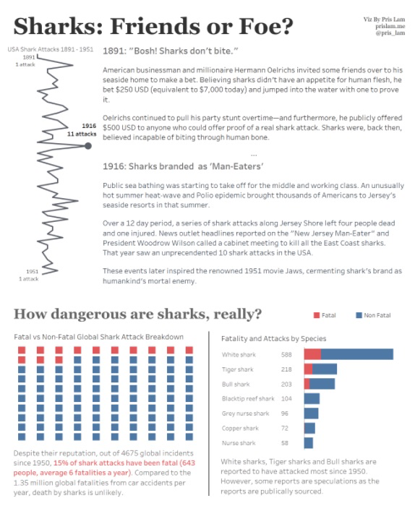
Why tell a story?
Data is important but can be difficult to understand.
A data storyteller helps pass on the importance of the story that the data tells.
Data can help influence how people perceive a topic and promote action.
This puts a lot of responsibility on the shoulders of the data storyteller.
Notes:
We’ve seen how important data can be and also how difficult it can be to interpret and understand it. Numbers and data need to be put into context for many people to fully comprehend what it shows. Data can help influence how people perceive a topic and promote action. This puts a lot of responsibility on the shoulders of the data storyteller. In this infographic shown here, the data storyteller has the responsibility of correctly showing data that will either prove that sharks are friends or convince people to stay out of the water and away from sharks. Let’s take a closer look at this infographic...

Slide 5
Why tell a story?
Live Code Showing the following infographics:
https://community.storytellingwithdata.com/challenges/dec-2019-infographics/sharks-friend-or-foe/images
https://community.storytellingwithdata.com/challenges/dec-2019-infographics/property-sales-in-greater-manchester-uk/images
https://community.storytellingwithdata.com/challenges/dec-2019-infographics/is-that-true-dui-arrests-of-nfl-players/images

Slide 6

Creating a Data Story
1. Start by knowing your audience.
2. Pinpoint the data that matters.
3. Outline the story arc.
Introduction
Explanation and interpretation
Conclusion
Source: https://venngage.com/blog/data-storytelling/
Notes:
There are a few steps that can be followed in order to create an effective data story. Start by knowing your audience. This could change depending on whether you decide to create an image to share on social media or maybe write a blog post instead. In step two - you will analyze and pinpoint the important data that will backup your story. The data used must be of good quality and the analysis should be complete and free of bias. Once you know what data will help your story along, you can outline the story arc - it should have a beginning or introduction, an explanation of the data, and a conclusion which includes next steps or action items that should follow.

Slide 7

Creating a Data Story
4. Create a draft design.
5. Assess your blind spots.
6. Polish up the visuals and share.
Source: https://venngage.com/blog/data-storytelling/
Notes:
The next step is when you get to tap into your artistic side! Draft a design that will be eye-catching and organized and includes all of the story elements and visuals that will explain and tell the data story. Don’t forget to assess your blind spots and have someone else review and leave feedback on your design, the data and the overall story. After that, you can polish up all the individual visuals and information and share your story!
The best part of creating a data story is that you can use your strengths and make the story more visual if you have artistic talent, or add more to the narrative if writing is your strength. You can also include a lot of data and interpretations if you enjoy that aspect of the data storytelling process the most.

Slide 8
Lesson Vocabulary
Term | Definition
data story | A story that is created with the intent to explain the data and why it matters.

